Slide 1






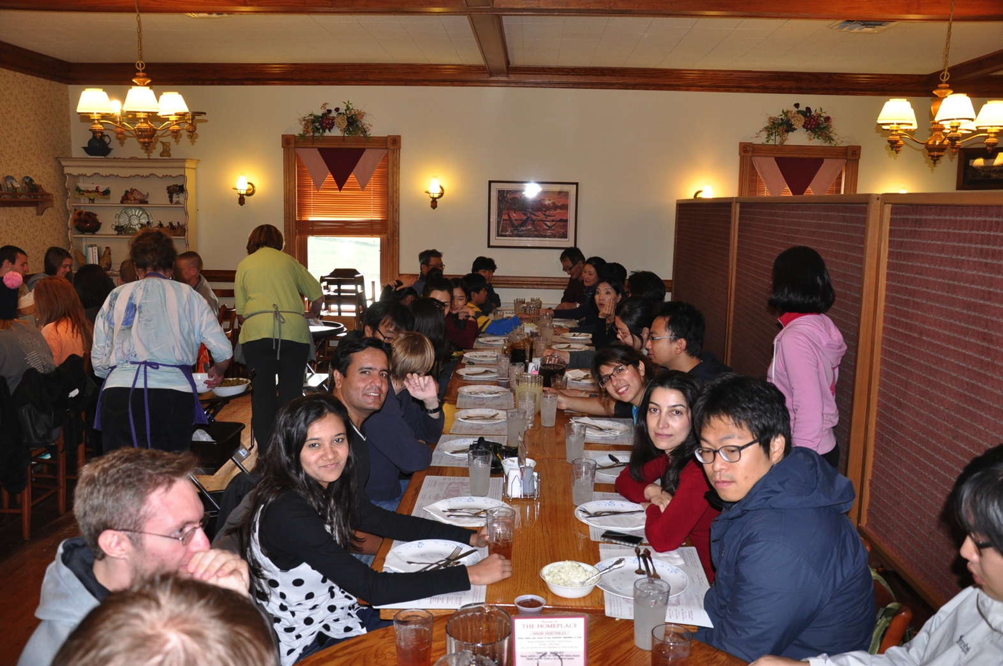
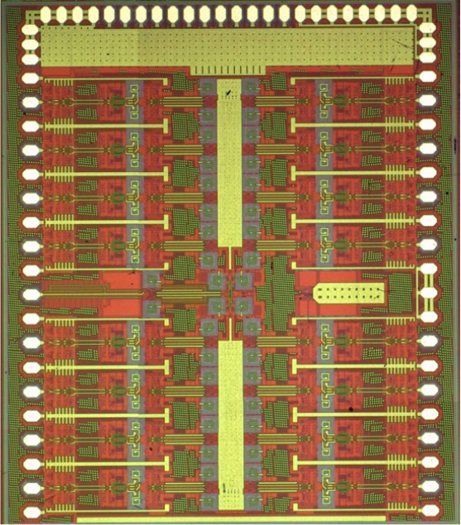
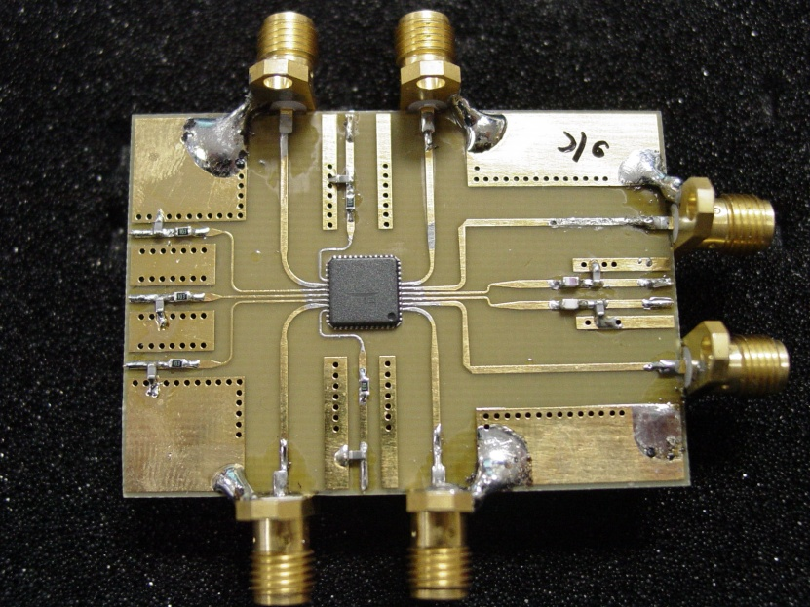
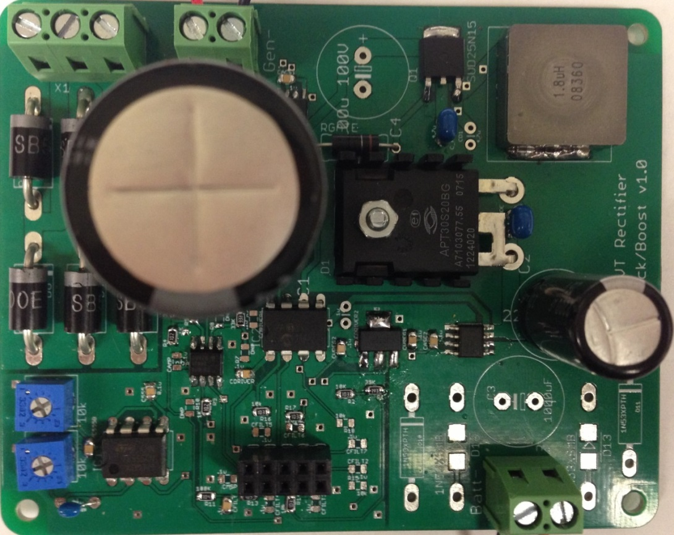

Overview
Mission
What Does MICS Offer?
Toward a Renowned Research Group
To conduct innovative research in analog / RF Ics, optoelectronics, and systems, and
To provide a high caliber educational experience.
To Industry
  Help recruiting students
  Help retraining engineers
  Collaborate in research
  Consulting
To students
  To be involved in cutting-edge research
  To work as a team in a global environment
Attract and maintain at least ten Industry Affiliated Program (IAP) members by 2008.
Apply for an NSF Engineering Research Center by 2013.
Pictures
Philosophy
Research Thrusts
Work hard, but remember this is life outside work.
Analog / Mixed-signal IC Thrust:
Optoelectronics Thrusts:
RF IC Thrust:
Systems Thrust:
Goals
We will be one of the best research groups in the nation nu 2010 through
  Collaboration and team work
  Quality research and publications
  Adequate Research Funding
History
Formed in August 2012.
Hosted industry people to two “MICS Day” events (Sept. 2012 & Dec. 2013)

