Slide 1

Transimpedance Amplifiers in CMOS Technology
for Optical Communications
over the Data Rate of 40 Gb/s
Joseph Chong
Dept. of Electrical and Computer Eng.
Virginia Tech
April 18, 2014

Slide 2
Outline
Motivation
Role of Transimpedance Amplifier (TIA)
TIA Circuit Topologies
Recent Literature
Proposed Design
Conclusion

Slide 3
Motivation
IEEE 802.3 supports 40 Gb/s and 100 Gb/s.
  Achieved with multiple channels such as 4 x 10 Gb/s.
Multiple channels pose drawbacks including:
  Inter-channel crosstalk.
  Large size.
  Possible of larger power consumption
Mitigate drawbacks by reducing the number of channels.
Much more with CMOS technology: lower power comparing to other techs, and enables integration.
Toward future standard of 400 Gb/s, is it possible to get 1 x 100 Gb/s in CMOS?

Slide 4
Part 1: Role of TIA

Slide 5
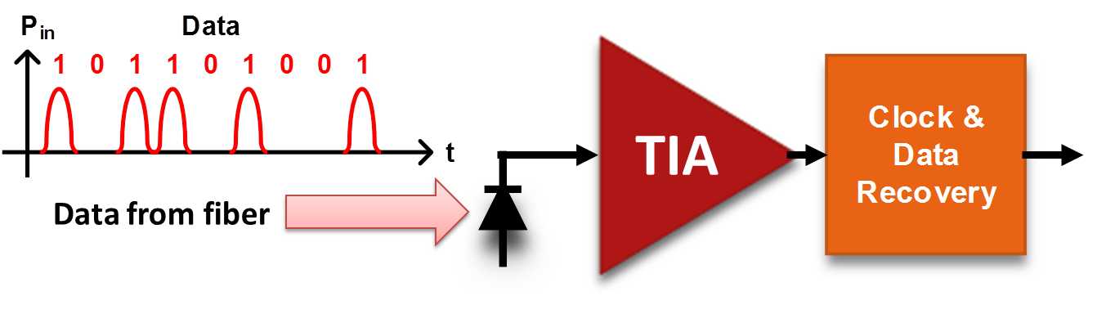
TIA in Optical Receiver
On-off keying modulated input.
Optical → electrical by photodiode.
I_{in} → V_{out} with TIA.
Restores clock & process data.

Slide 6
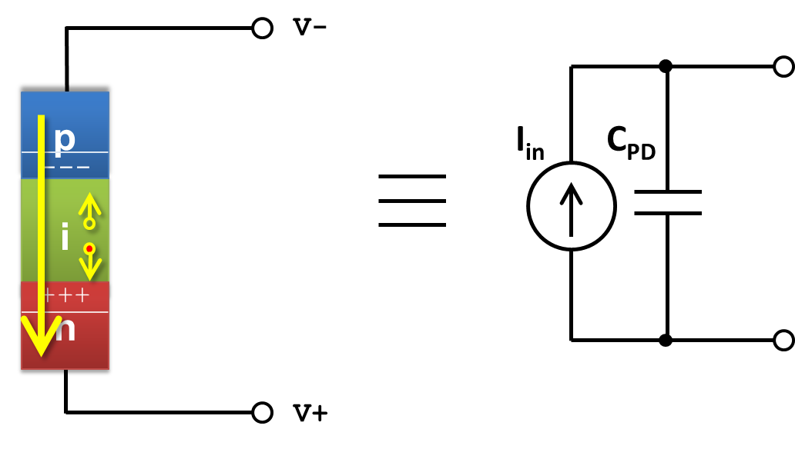
Photodiode
A P-I-N diode has a wider depletion region.
Reversed biased and equivalent to a capacitor.
Optical power input controls an AC current source.

Slide 7
TIA Performance
TIA dominates performance of receiver.
Performance metrics:
  Gain
  Group delay variation
  Bandwidth
  Noise
Will be discussed in next section.

Slide 8


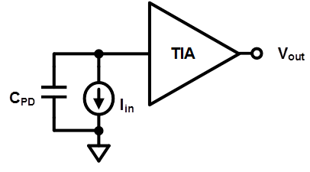
Transimpedance Gain
Transfer function:
In decibel (dB) scale:
Transimpedance gain

Slide 9


Group Delay
Transfer function
Obtain group delay (GD) from phase.
Group delay variation (GDV) is τ_{max} – τ_{min} within bandwidth.

Slide 10
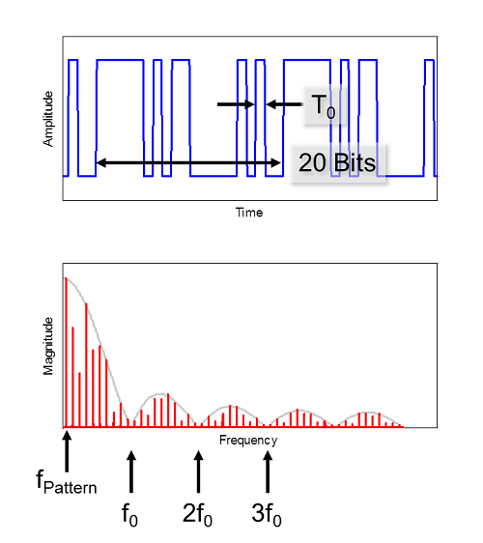
Bandwidth
A digital signal has wide range of frequency components.
Bandwidth (BW) of TIA requires a pass band from near DC to near f_{0.}
3-dB frequency is where Z_{T} is 1/2 of low frequency gain.
A rule of thumb relates 3-dB freq. to data rate.
f₀
f_{3dB}
Image courtesy of http://edn.com/design/test-and-measurement/4422710/The-basics-of-digital-signal-spectra

Slide 11
Bandwidth
40 Gb/s
100 Gb/s
f_{3dB}
f₀
f₀ = 40 GHz
f₀ = 100 GHz
f_{3dB} = 28 GHz
f_{3dB} = 70 GHz
Image courtesy of http://edn.com/design/test-and-measurement/4422710/The-basics-of-digital-signal-spectra

Slide 12
Part 2: Representative TIA

Slide 13
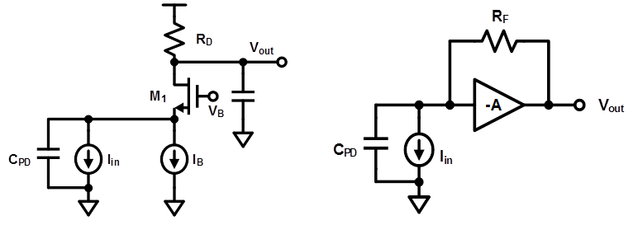
Representative TIA
Two commonly used circuit topologies:
  Common gate (CG) amplifier
  Shunt-feedback (S-FB) amplifier

Slide 14

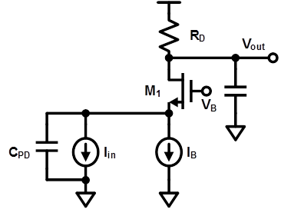
CG: Gain and Bandwidth
Transfer function:
Pole frequency associated with C_{PD}:
Increase g_{m1} for larger bandwidth.
  Increase width of M₁ → larger C_{gs}
  Increase bias current → R_{D} voltage drop
Low freq gain = R_{D}
0
0

Slide 15
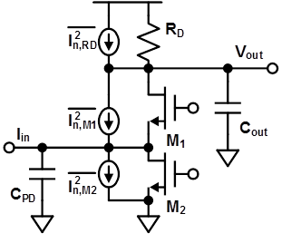


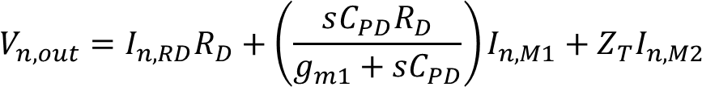
CG: Noise at Vout
Noise from R_{D}:
Noise from M₁ and M₂ :
V_{out} due to superposition of current sources :
How to compare noise with other TIA?
Larger gain ➔ larger output noise, but not worse signal-to-noise ratio.

Slide 16
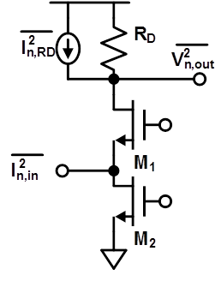


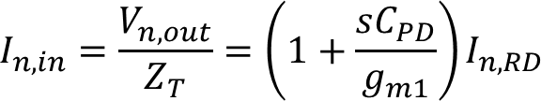
Input Referred Noise
Compare by the equivalent input noise current (input referred noise).
Calculation procedure:
  Output noise due to resistor R_{D}
  Transfer function
  Input referred noise
Enables fair comparisons between designs.

Slide 17
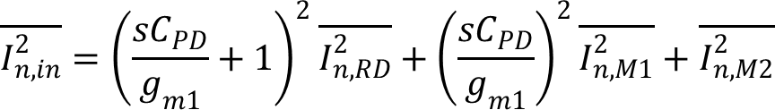
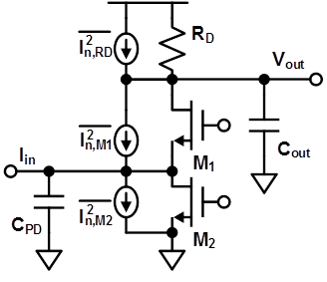
CG: Input Referred Noise
Express noise in current density: mean square current per hertz.
Observe from equation above, noise of R_{D} and M₂ is directly referred to the input.

Slide 18
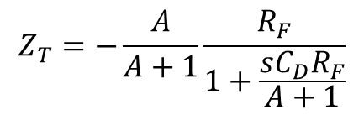
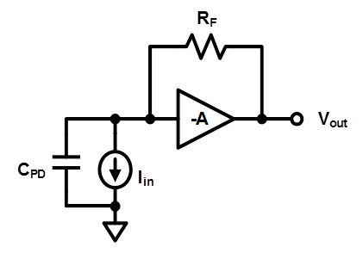
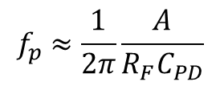
S-FB: Gain and Bandwidth
A Shunt feedback (S-FB) amplifier is composed of a voltage amplifier with gain –A and RF as feedback.
Transimpedance gain
Pole frequency
At A>>1, Low freq gain = R_{F}
1
0

Slide 19

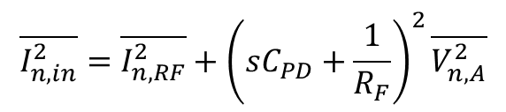
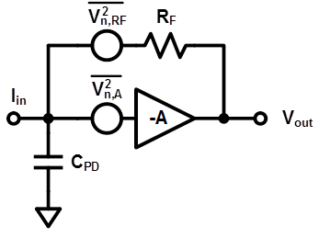
S-FB: Input Referred Noise
Noise of amplifier A is modeled as voltage
Input referred noise:

Slide 20
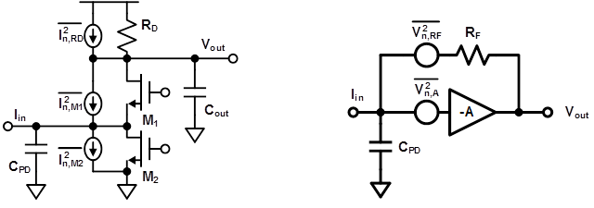
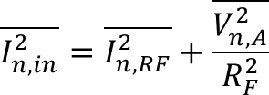

Comparison: Noise
Comparing low frequency noise
  The noises from R_{D} and R_{F} are identical.
  The noise from V_{n,A} can be smaller than the noise from M₂.

Slide 21
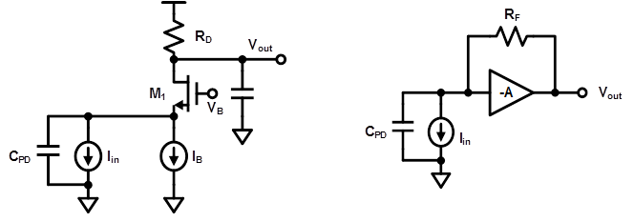
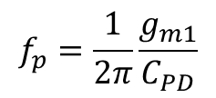
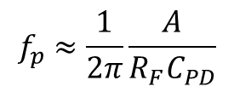
Comparison: Bandwidth
CG’s dominant pole is associated with 1/g_{m}.
S-FB’s pole is associated with R_{F}/A, which can be larger than 1/g_{m}.

Slide 22
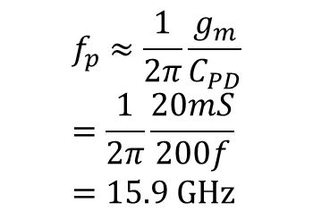
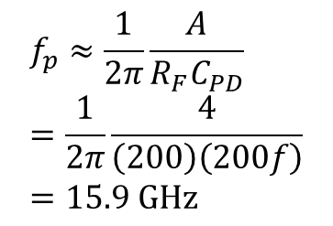
Possibility for 40 Gb/s?
Some numerical examples for the two topologies.
Z_{T} = R_{D} = R_{F} = 200 = 46dB
Input pole frequency = 15.9GHz.
How to achieve 40Gb/s?

Slide 23

Filling the Gap

Slide 24
Part 3: Recent Literature
(Bandwidth Enhancement Techniques)

Slide 25
Methods of Bandwidth Enhancement
Series interstage inductor
π-type inductor network
Triple resonance network
g_{m}-boosting topology
Inductors
Circuit Topology

Slide 26
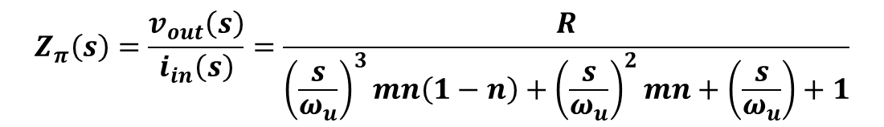
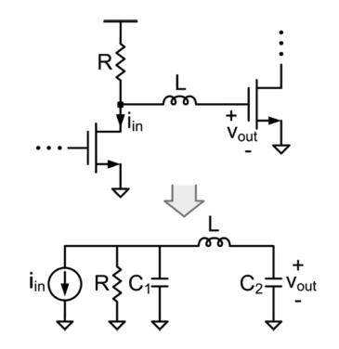



Series Inductor (1)
Transfer function:
Parameters:
J. Kim and J. F. Buckwalter, “Bandwidth Enhancement With Low Group-Delay Variation for a 40-Gb/s Transimpedance Amplifier,” IEEE Trans. Circuits Syst. I Regul. Pap., vol. 57, no. 8, pp. 1964–1972, 2010.

Slide 27
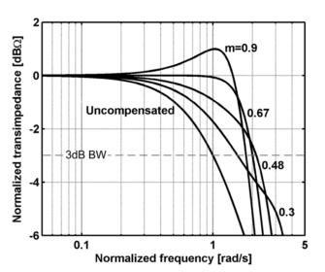
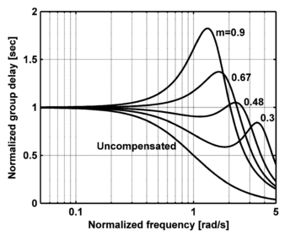
Series Inductor (2)
Optimal m value, which translates to L value, provides adequate BW enhancement and minimal GDV.
Gain
Group
Delay
GDV
BW
J. Kim and J. F. Buckwalter, “Bandwidth Enhancement With Low Group-Delay Variation for a 40-Gb/s Transimpedance Amplifier,” IEEE Trans. Circuits Syst. I Regul. Pap., vol. 57, no. 8, pp. 1964–1972, 2010.

Slide 28
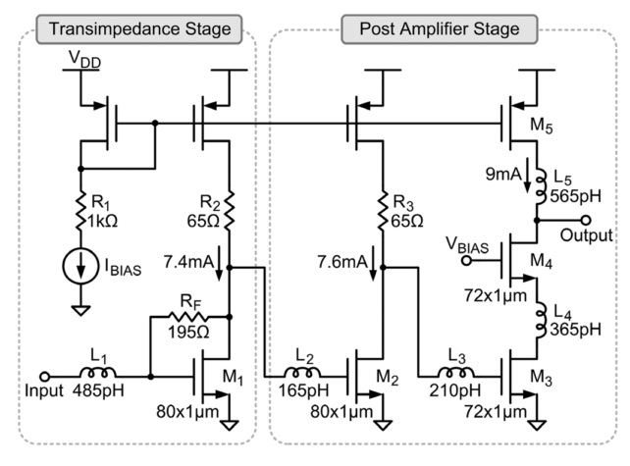
Series Inductor (3)
The first work (2010) is a S-FB amplifier followed by 2 stages of post-amplifiers in 0.13 µm CMOS.
Bandwidth is extended from 5GHz to 30GHz.
GDV is kept within 12ps.
J. Kim and J. F. Buckwalter, “Bandwidth Enhancement With Low Group-Delay Variation for a 40-Gb/s Transimpedance Amplifier,” IEEE Trans. Circuits Syst. I Regul. Pap., vol. 57, no. 8, pp. 1964–1972, 2010.

Slide 29
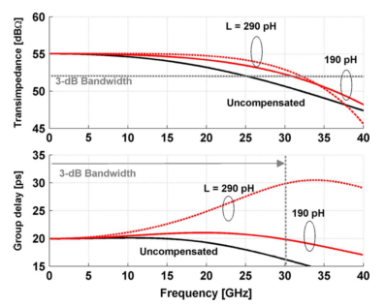
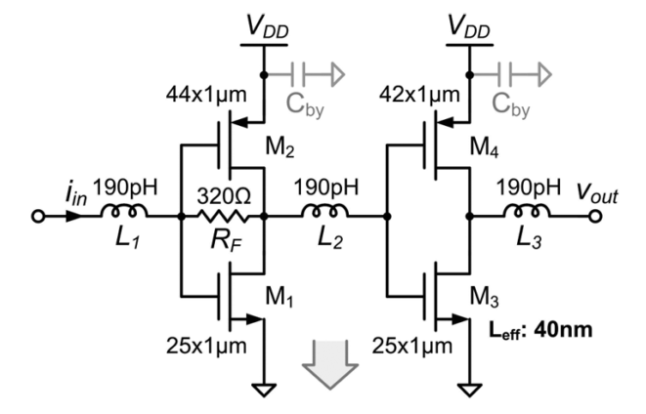
Series Inductor (4)
The second work (2012) is a push-pull S-FB amplifier followed by one stage of post-amplifier fabricated in 45 nm SOI CMOS.
Bandwidth is extended from 25 GHz to 33 GHz.
GDV is kept within 6ps.
J. Kim and J. F. Buckwalter, “A 40-Gb/s Optical Transceiver Front-End in 45 nm SOI CMOS,” IEEE J. Solid State Circuits, vol. 47, no. 3, pp. 615–626, 2012.

Slide 30
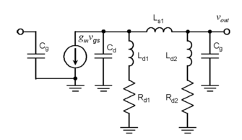
π-type Inductor Peaking (1)
A π-type inductor peaking utilizes three interstage inductors for bandwidth enhancement purposes.
The small signal equivalent circuit shows that:
  C_{d} is the drain capacitance of 1st stage.
  C_{g} is the gate capacitance (of next stage).
J.-D. Jin and S. S. H. Hsu, “A 40-Gb/s Transimpedance Amplifier in 0.18-um CMOS Technology,” IEEE J. Solid State Circuits, vol. 43, no. 6, pp. 1449–1457, 2008.

Slide 31
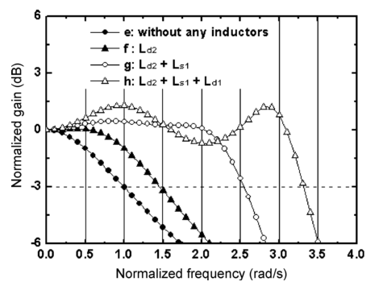
π-type Inductor Peaking (2)
Gain enhancement of more than 3 times is achieved.
J.-D. Jin and S. S. H. Hsu, “A 40-Gb/s Transimpedance Amplifier in 0.18-um CMOS Technology,” IEEE J. Solid State Circuits, vol. 43, no. 6, pp. 1449–1457, 2008.

Slide 32
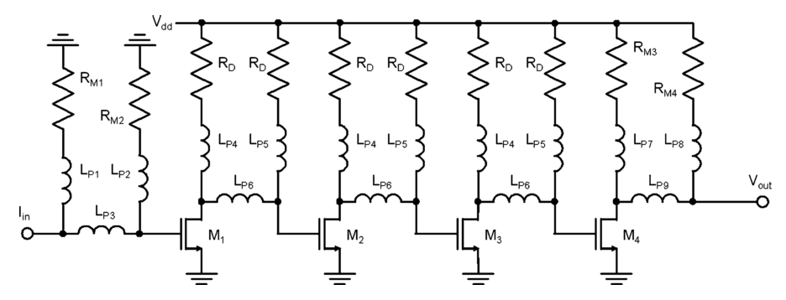
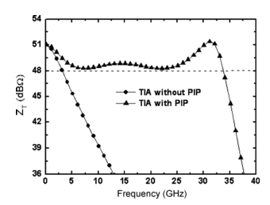
π-type Inductor Peaking (3)
Jin and Hsu proposed a four-stage common source amplifier with π-type inductor peaking in 0.18 µm CMOS.
3-dB bandwidth is extended from 5GHz to 30GHz.
J.-D. Jin and S. S. H. Hsu, “A 40-Gb/s Transimpedance Amplifier in 0.18-um CMOS Technology,” IEEE J. Solid State Circuits, vol. 43, no. 6, pp. 1449–1457, 2008.

Slide 33
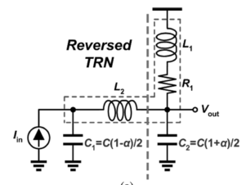
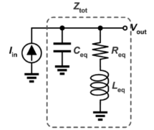
TRN (1)
A triple resonance network (TRN) is composed of one series inductor and one shunt inductor.
Reverse TRN has R₁ and L₁ connected to C₂.
Entire network can be simplified as a circuit of C parallel with RL.
C.-F. Liao and S.-I. Liu, “40 Gb/s Transimpedance-AGC Amplifier and CDR Circuit for Broadband Data Receivers in 90 nm CMOS,” IEEE J. Solid-State Circuits, vol. 43, no. 3, pp. 642–655, 2008.

Slide 34
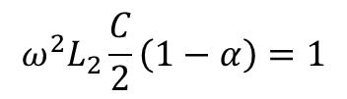
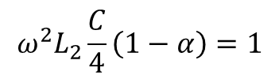
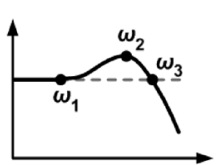
TRN (2)
Drain impedance:
Three resonance frequencies:
  ω₁: ( R_{eq} and L_{eq} branch is inf.)
  ω₂: ( C_{eq} branch is inf.)
  ω₃: Z_{tot} is pure resistive
C.-F. Liao and S.-I. Liu, “40 Gb/s Transimpedance-AGC Amplifier and CDR Circuit for Broadband Data Receivers in 90 nm CMOS,” IEEE J. Solid-State Circuits, vol. 43, no. 3, pp. 642–655, 2008.

Slide 35
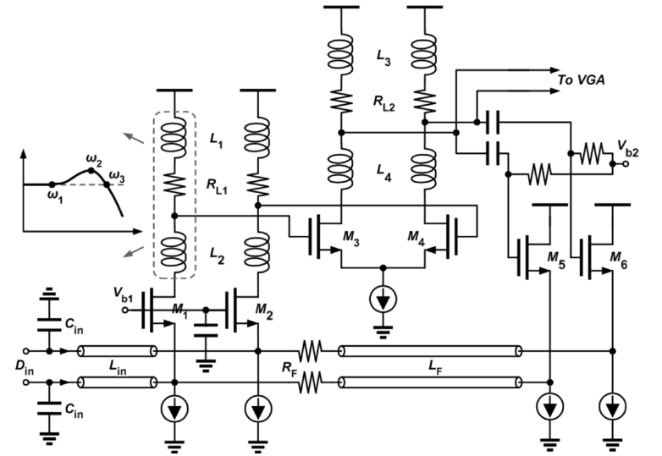
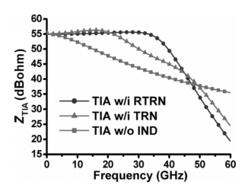
TRN (3)
A S-FB CG in 90 nm CMOS by Liao and Liu (2008).
Bandwidth enhancement from 5GHz to 40GHz.
C.-F. Liao and S.-I. Liu, “40 Gb/s Transimpedance-AGC Amplifier and CDR Circuit for Broadband Data Receivers in 90 nm CMOS,” IEEE J. Solid-State Circuits, vol. 43, no. 3, pp. 642–655, 2008.

Slide 36
Inductor Peaking Downsides
Three types of inductor peaking presented shows attractive results
However, there are some downsides.
  Inductors occupies large chip area.
  Large inductors have low self resonance freq.
  On chip inductors have low Q value.
  Series inductors extend bandwidth while increasing frequency dependent delay.

Slide 37
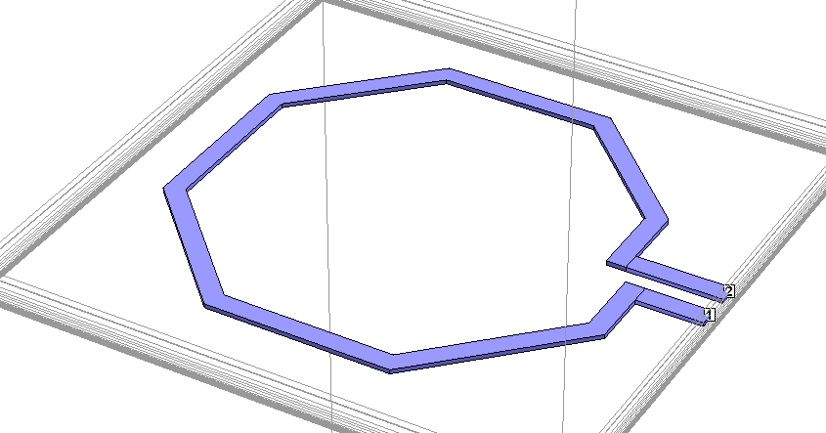
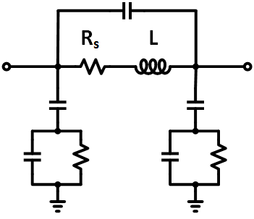
Implementation of On Chip Inductors
On chip inductors are implemented as spiral metal.
Commonly used model shows capacitance coupling, parasitic loss and substrate loss.

Slide 38

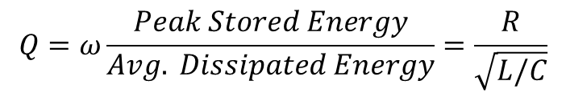
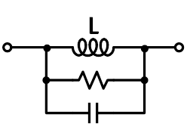
Inductor Parameters
Convert the inductor model to a parallel RLC circuit.
Definition of self resonance frequency (SRF):
Definition of Q value:

Slide 39
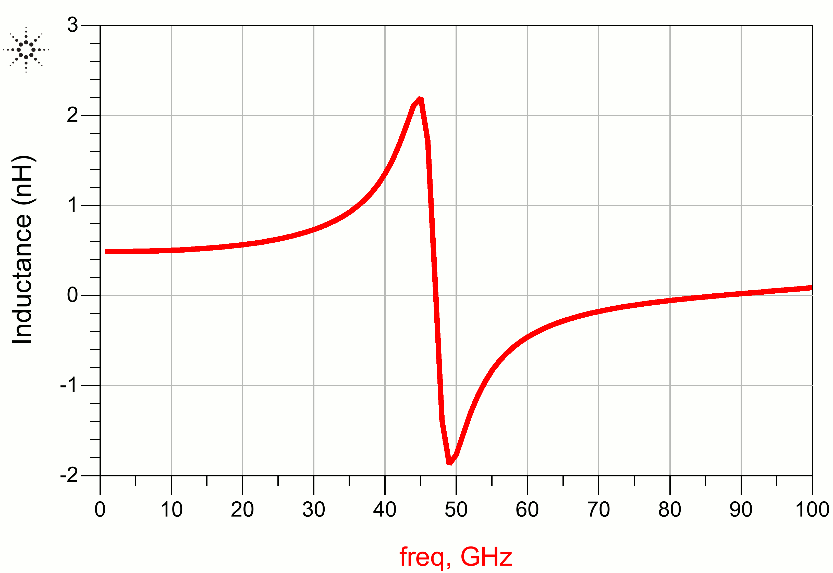
Self Resonance Frequency
After the inductor’s self resonance frequency, capacitance becomes dominant in the structure.
inductor
imag(Z)/ω
capacitor
freq (GHz)

Slide 40
Effect of Q value
Lower Q value causes deterioration of bandwidth enhancement effect.
Normalized Vout (dB)
No Inductor
Q=10
Q=25
freq (GHz)

Slide 41
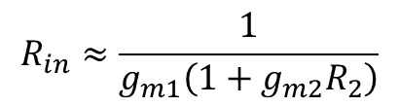
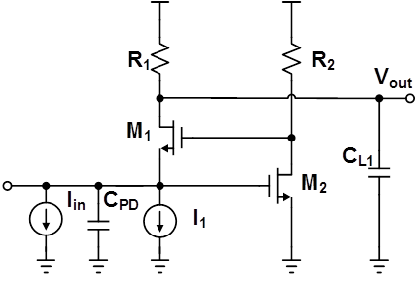
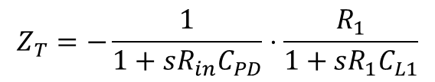

g_{m}-boosting (1)
Based on CG amplifier M₁ and R₁.
Common source M₂ and R₂ feeds to gate of M₁.
Input resistance:
Transfer function:
Pole associated with C_{PD}:

Slide 42


g_{m}-boosting (2)
Bashiri and Plett (2010) proposed g_{m}-boosting with inductor peaking design in 65nm CMOS.
Achieves 2 times bandwidth enhancement.
S. Bashiri and C. Plett, “A 40 Gb/s transimpedance amplifier in 65 nm CMOS,” in IEEE International Symposium on Circuits and Systems (ISCAS), 2010, pp. 757–760.

Slide 43
Summary of Techniques
Ref. | CMOS Process | ZT (dBΩ) | Enhanced BW | Bandwidth Enhancement Techniques
Jin & Hsu 2008 | 0.18 μm | 51 | 30.5 | π-type inductor peaking
Liao & Liu 2008 | 90 nm | 60 | 40 | Reverse triple resonance
Kim & Buckwalter 2010 | 0.13 μm | 50 | 29 | Series interstage inductor
Kim & Buckwalter 2012 | 45 nm SOI | 55 | 41 | Series interstage inductor
Bashiri & Plett 2010 | 65 nm | 46.7 | 38 | g_{m}-boosting with inductors
>28GHz, Works at 40 Gb/s!

Slide 44
Part 4
Proposed Design for 100 Gb/s

Slide 45

Overall Circuit
g_{m}-boosting transimpedance stage
Capacitive degeneration stage
Inductive peaking
Differential signaling

Slide 46


gm-boosting Stage
Transfer function:
L₁ and L₃ introduce peaking
in transfer function.

Slide 47


Capacitive Degeneration
Voltage gain function:
Zero can be used to compensate a pole.

Slide 48

TIA Bandwidth and Gain
Bandwidth: 75 GHz >70GHz, Works at 100 Gb/s!
Gain: 40 dBΩ
-3dB
75

Slide 49
Comparison
Figure of merit “BW(GHz) x Z_{T,mag} / Power (mW)”.
Ref. | Process | BW (GHz) | ZT (dBΩ) | GDV (ps) | Noise (pA/√Hz) | Power (mW) | FOM
Proposed Design | 65 nm | 75 | 40 | 8.7 | 31 | 24 | 312.5
Jin & Hsu 2008 | 0.18 μm | 30.5 | 51 | 150 | 55.7 | 60.1 | 180.1
Liao & Liu 2008 | 90 nm | 22 | 60 | n/a | 22 | 75 | 293.3
Kim & Buckwalter 2010 | 0.13 μm | 29 | 50 | 12 | 51.8 | 45.7 | 200.7
Kim & Buckwalter 2012 | 45 nm SOI | 30 | 55 | 7.8 | 20.5 | 9 | 1874.5
Bashiri & Plett 2010 | 65 nm | 19 | 46.7 | 13 | 30 | 39.9 | 103.0

Slide 50
Conclusion
IEEE standard has motivated several 40 Gb/s TIA in CMOS, which target low power and high integration application.
Most TIA designs are based on CG or S-FB circuit.
Bandwidth enhancement techniques are necessary for 40 Gb/s and beyond.
Inductor peaking is the most widely used technique.
A TIA designed in 65nm CMOS achieves 75 GHz bandwidth, shows promising results to work at a 100 Gb/s data rate.

Slide 51
Reference
B. Razavi, Design of Integrated Circuits for Optical Communications, 2nd ed., Wiley, 2012.
B. Razavi, RF Microelectronics, 2nd ed., Pearson Education, 2012.
J. Kim and J. F. Buckwalter, “Bandwidth Enhancement With Low Group-Delay Variation for a 40-Gb/s Transimpedance Amplifier,” IEEE Trans. Circuits Syst. I Regul. Pap., vol. 57, no. 8, pp. 1964–1972, 2010.
J. Kim and J. F. Buckwalter, “A 40-Gb/s Optical Transceiver Front-End in 45 nm SOI CMOS,” IEEE J. Solid State Circuits, vol. 47, no. 3, pp. 615–626, 2012.
J.-D. Jin and S. S. H. Hsu, “A 40-Gb/s Transimpedance Amplifier in 0.18-um CMOS Technology,” IEEE J. Solid State Circuits, vol. 43, no. 6, pp. 1449–1457, 2008.
C.-F. Liao and S.-I. Liu, “40 Gb/s Transimpedance-AGC Amplifier and CDR Circuit for Broadband Data Receivers in 90 nm CMOS,” IEEE J. Solid-State Circuits, vol. 43, no. 3, pp. 642–655, 2008.
S. Bashiri and C. Plett, “A 40 Gb/s transimpedance amplifier in 65 nm CMOS,” in IEEE International Symposium on Circuits and Systems (ISCAS), 2010, pp. 757–760.

Slide 52

Thank you!

