Slide 1
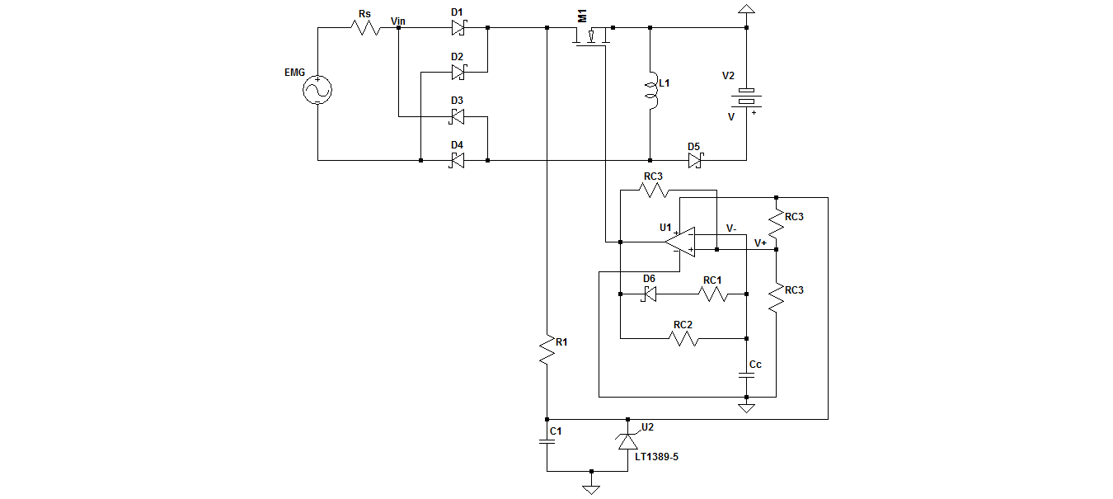
Vibration Energy Harvesting Circuit to Power Wireless Sensor Nodes
Alanté Dancy (M.S. Student) and Dong Ha
Introduction:
Currently, wireless sensor nodes (WSNs) are battery-powered and must be replaced continuously. It is advantageous to embed sensors in systems to obtain accurate measurements:
Pressure
Temperature
Humidity
Vibration
The main goal of the circuit is to harvest bridge or mechanical vibrations efficiently and then ultimately output 3.3 V_{DC} and 1.8 V_{DC} to power communication devices.
Design Approach:
The first step is to rectify the input voltage so that DC voltage is inputted into the buck-boost converter.
An appropriate duty-cycle and switching frequency were selected for maximum output power and to operate in DCM.
Selection of the MOSFET was based off the transistor’s drain-to-source on resistance and gate charge values. The product of these two values are kept low to reduce power loss.
Circuit Schematic:
Buck-Boost Converter:
Resistive impedance matching is heavily used in this circuit to obtain maximum output power.
Schottky diodes are used because of their low forward voltage at low forward currents
EMG Specifications:
R_{s} = 300 Ω
V_{pp} = 10 V
F_{s} = 50 Hz
Design objectives:
High efficiency
V_{out} = 3.3 V
V_{out} = 1.8 V
- - Bridge Rectifier
- - Buck-Boost Converter
- - Oscillator
Results:
The load resistance was adjusted to obtain the maximum power at the output.
Oscillator Design:
To make the system completely standalone, a low-power oscillator is used to drive the gate signal.
The input voltage combined with a voltage regulator supplies enough power to supply the oscillator.
Using the following equations, applying the assumption that R_{C2} is much greater than R_{C1} then the duty-cycle and frequency and frequency can be approximated as follows:
$D_{1}≈ \frac{R_{C1}}{R_{C2}}$
$F_{s}≈ \frac{1}{{(R_{C1}+R}_{C2})C_{C}ln2}$
The oscillator is selected to operate at 100 kHz. At this frequency the input resembles a DC voltage with the frequency of the EMG being 50 Hz
Parameter | Value
Input Power | 39.72 mW
Output Power | 33.30 mW
Efficiency | 83.83%
Conclusions:
Designed an energy harvesting circuit to power WSNs embedded in bridges or industrial machines.
Utilized a standalone oscillator to regulate the transistor which allows for no external connections.
Simulated the circuit to obtain an efficiency that will be improved through loss analysis.

